Slide 1
Online Mapping of Commonwealth Campuses
Leigh Hastings & Adam Aharonian

Slide 2
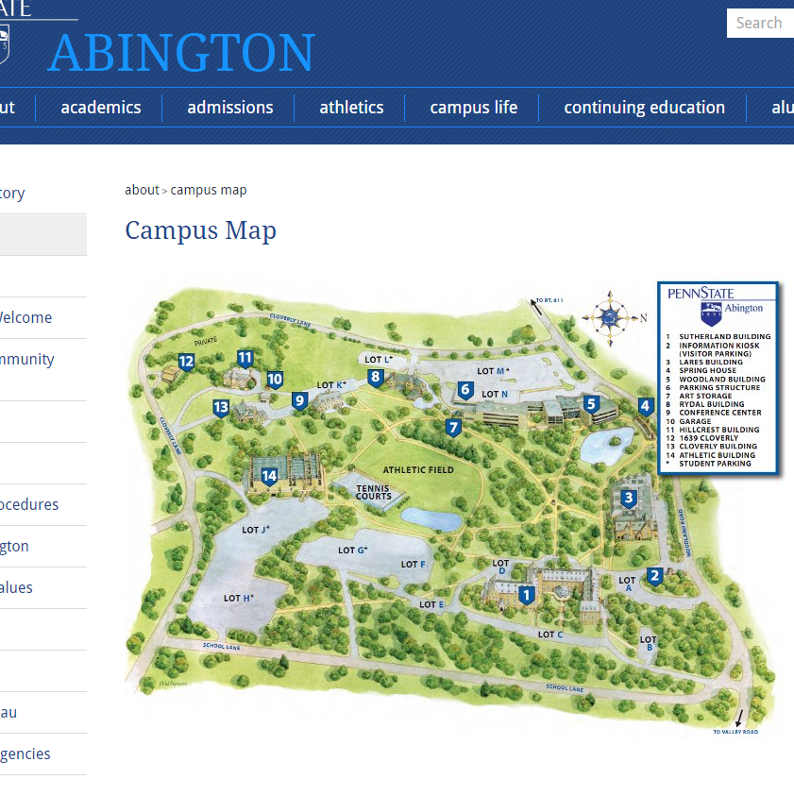
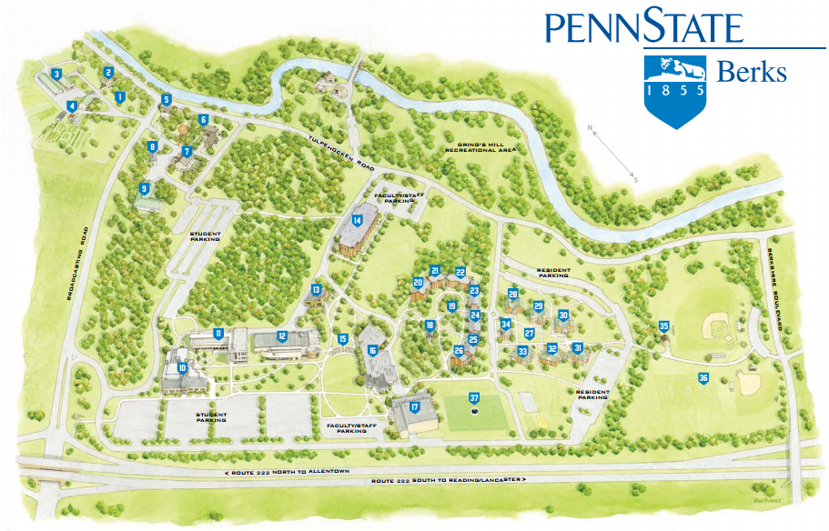
Commonwealth Campuses

Slide 3
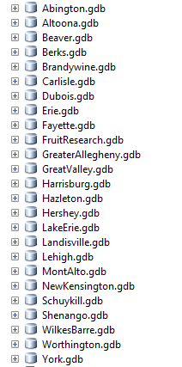
Commonwealth Campus Data from OPP
Databases from OPP of 25 commonwealth campuses
Split up between two students- myself and Adam
Abington-Harrisburg: Adam
Hazleton-York: Leigh
Geodatabases include shapefiles for:
Buildings
Sidewalks
Roads (Major, Minor, and Unpaved)
Parking

Slide 4
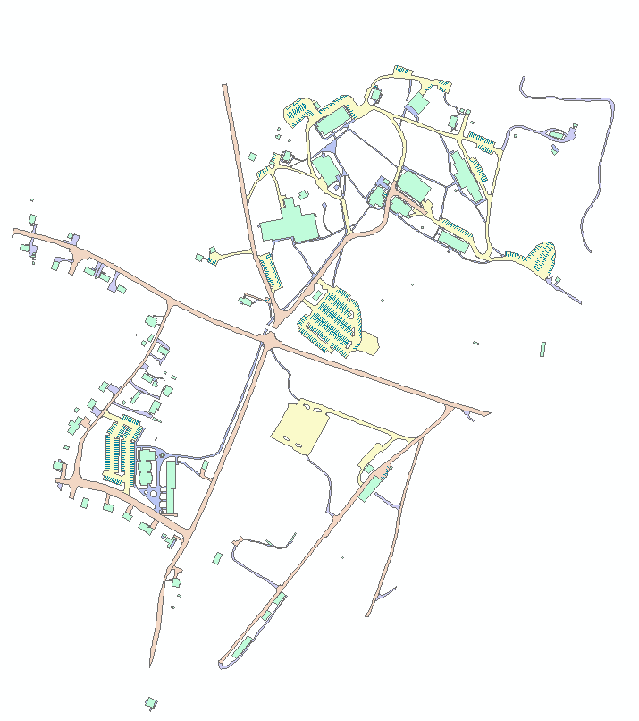
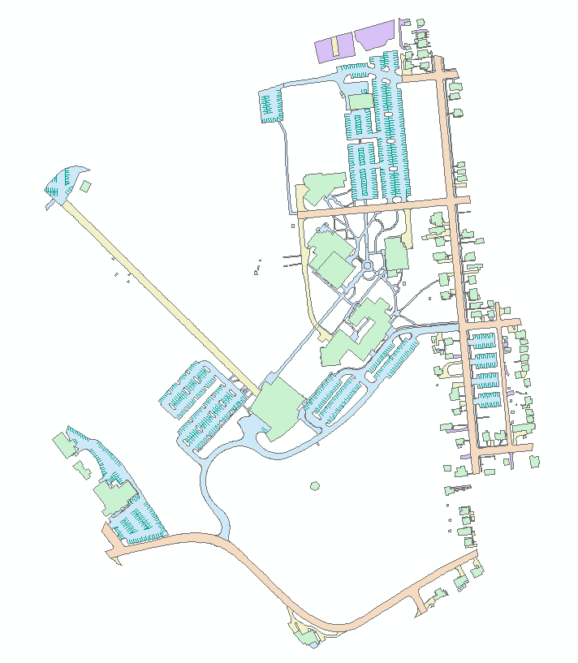
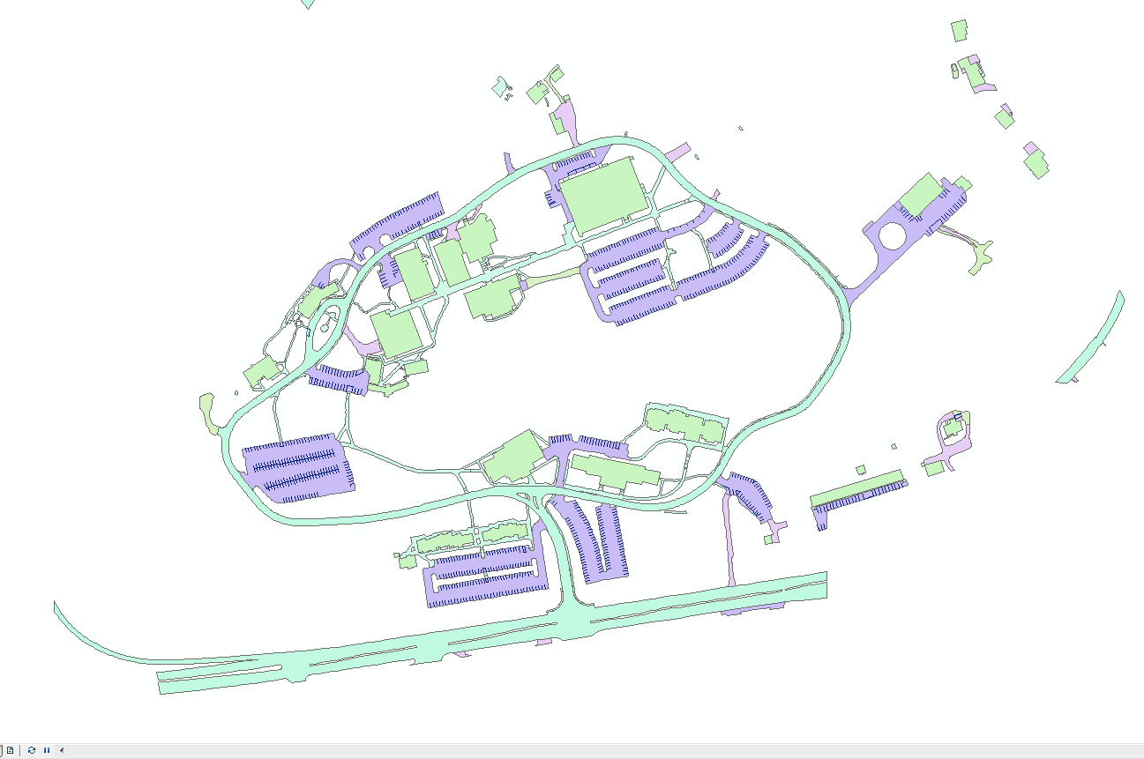
Penn State York
Penn State Mont Alto
Penn State Hazleton

Slide 5
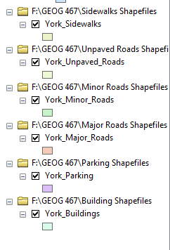
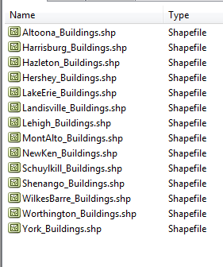
Preparing files for Mapbox
Export each separate shapefile as a new shapefile with appropriate name and re-project in WGS 84 in ArcMap
Do this for all files for every campus

Slide 6

Issues with Mapbox
Experienced many issues with Mapbox but shapefiles are ready for further use.
Error with C drive
Error with bounds

Slide 7
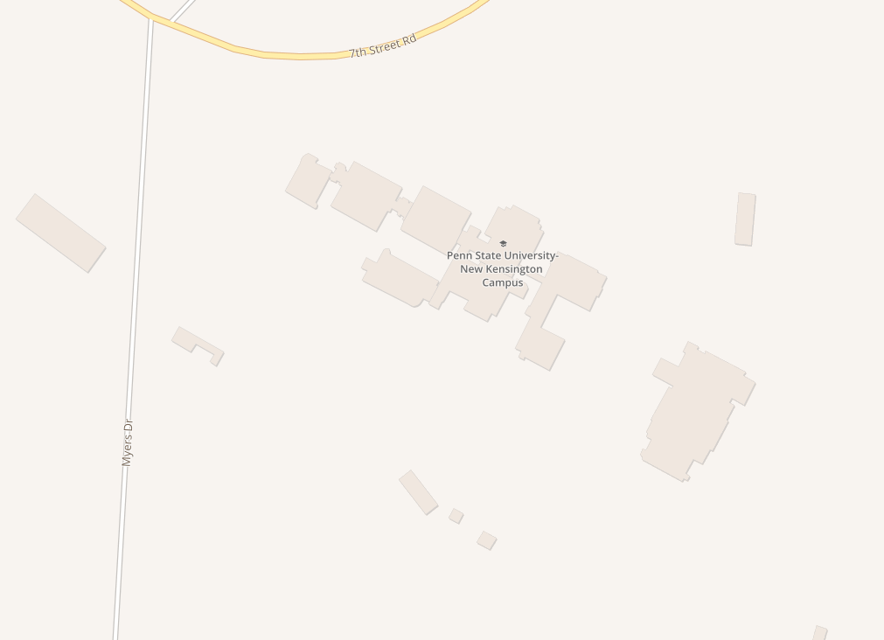
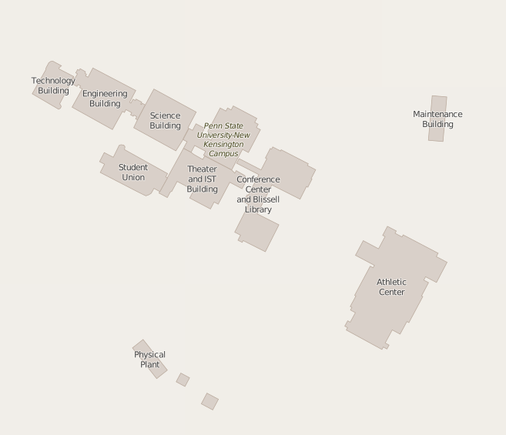
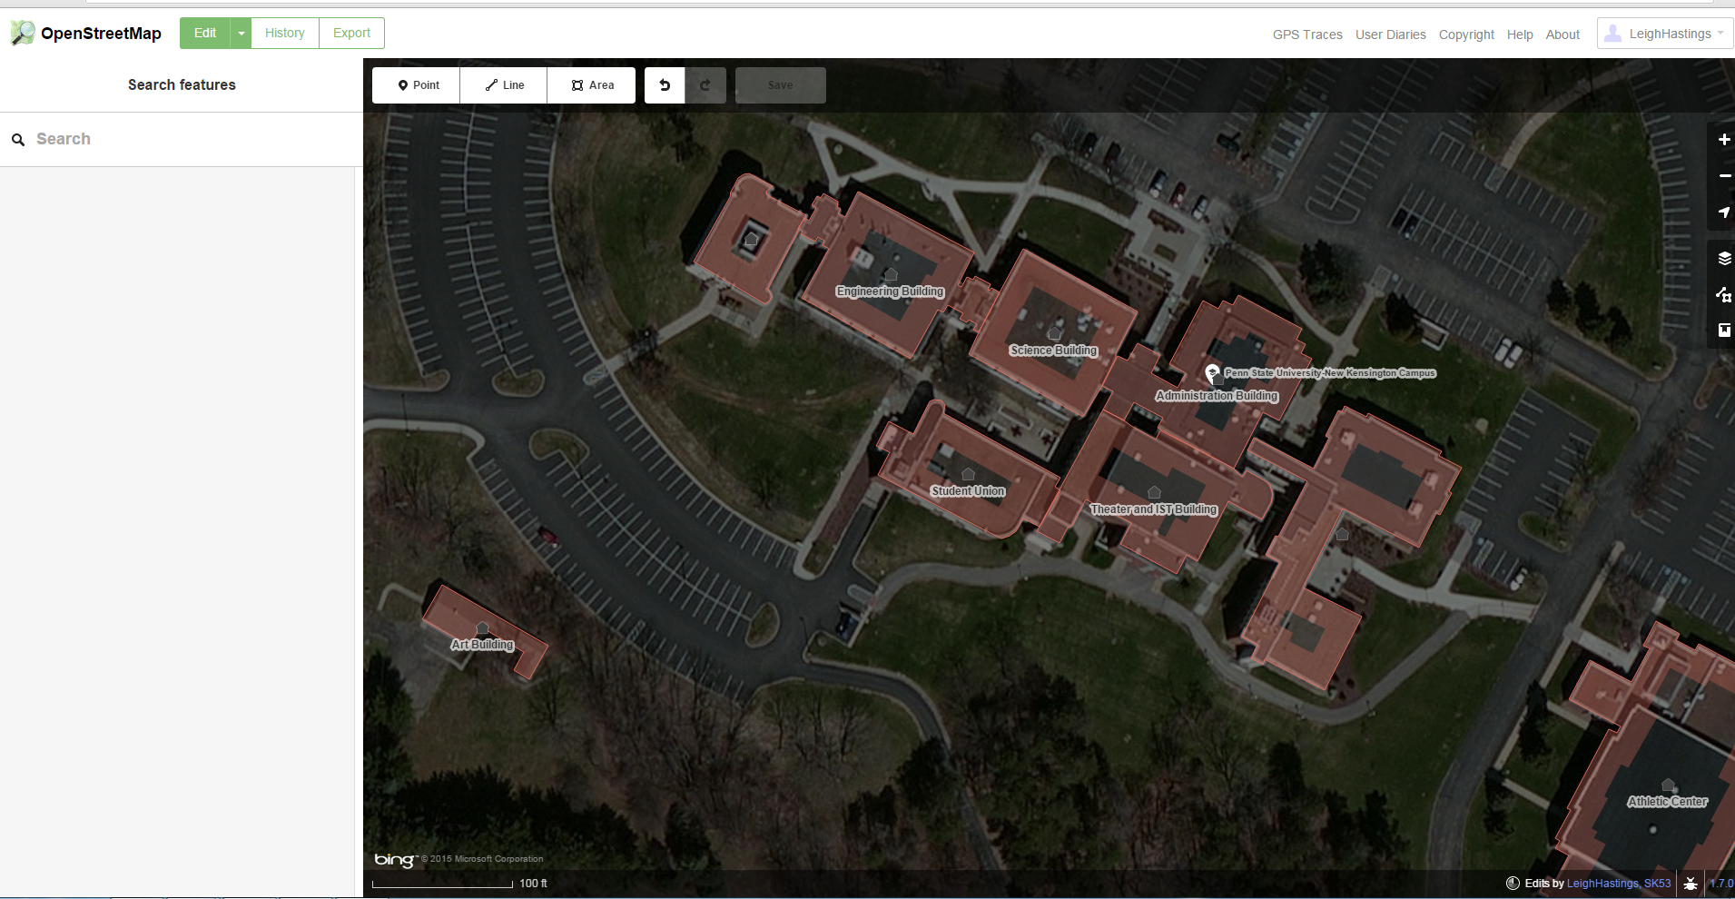
OpenStreetMap (OSM)
Many campuses had little to no information on OSM
Traced buildings
Added Building Name Attributes
OSM
Mapbox

Slide 8
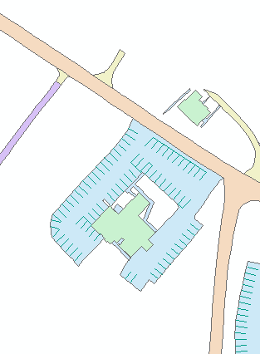
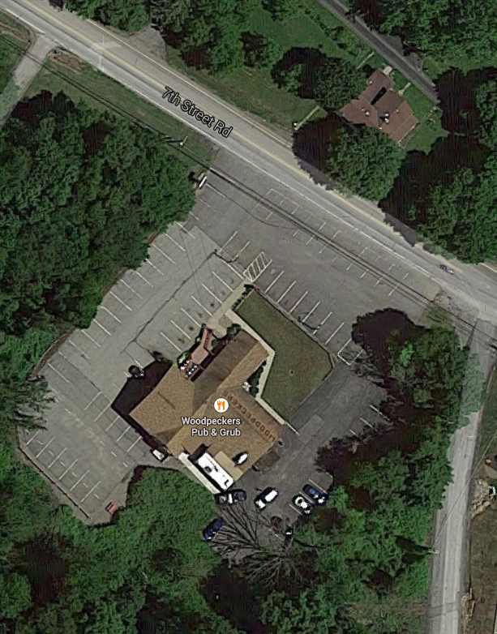
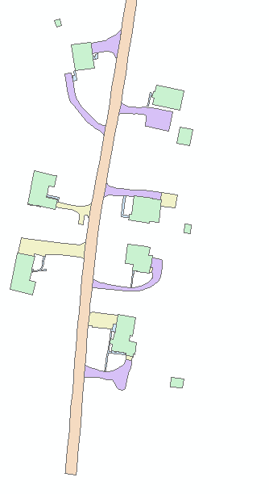
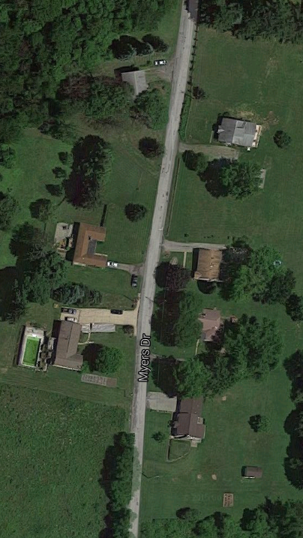
Problems with OPP Data

Slide 9

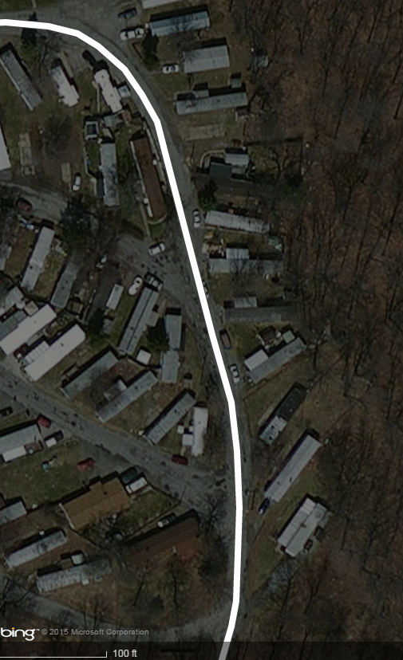
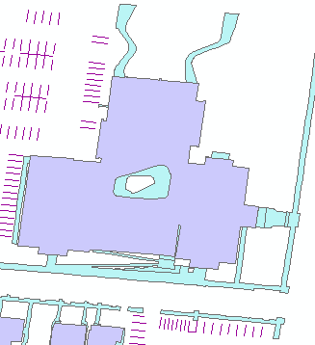
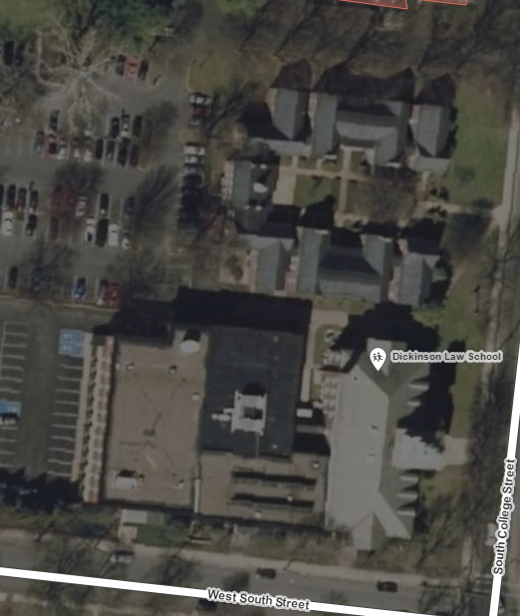
Problems with OPP data

Slide 10
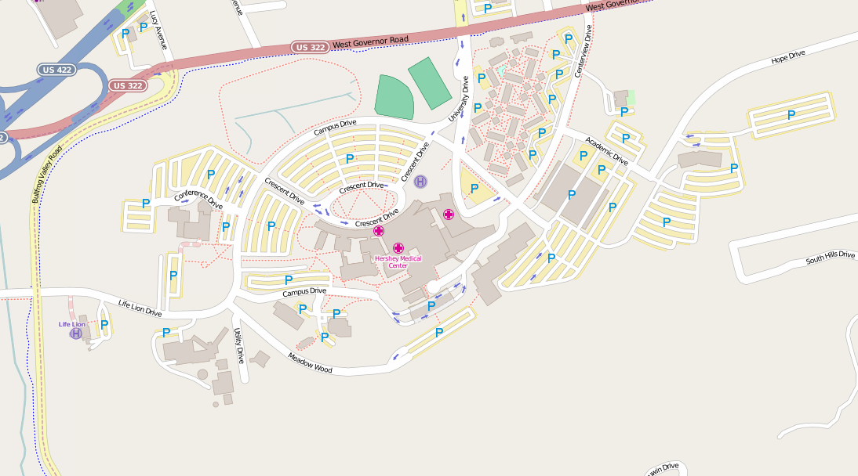
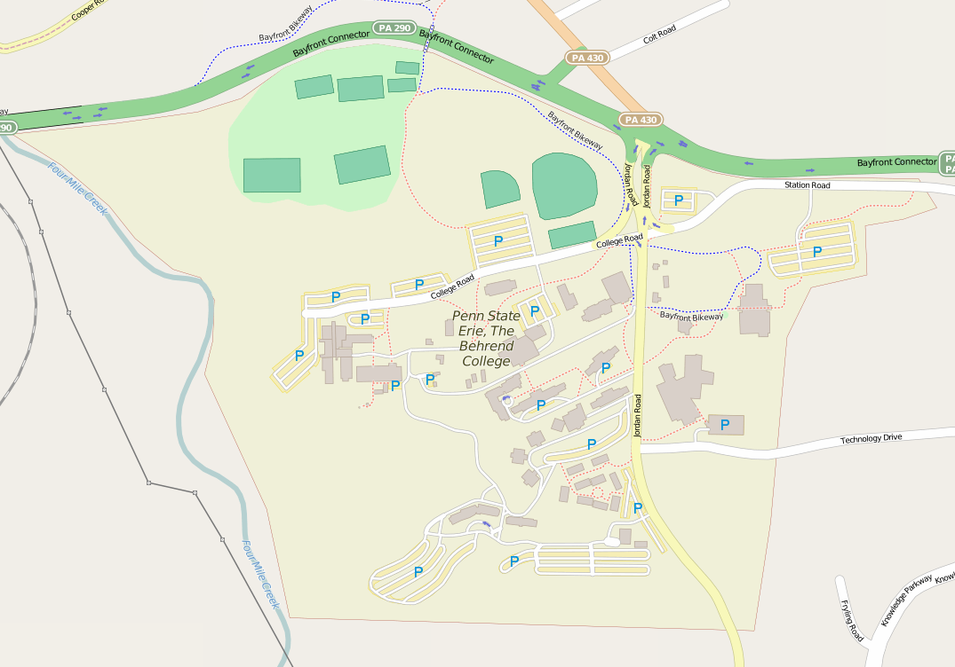
Potential for OSM and All Campuses

Slide 11
Future Work
Future work:
Trace parking lots
Trace sidewalks
Campus roads?
Add more attributes to buildings
Classrooms
Floors/Stories
Handicap accessibility
Reach out to commonwealth campuses to finalize their attributes and regions

